Slide 1




The course notes are partly based on the Machine learning course presented by Andrew Ng at Stanford University and the original can be found at https://www.coursera.org/course/ml b
e.
All materials without annotations or marks are copyrighted by their copyright owner.
All the codes and modified slides are available at Github
The project homepage:
https://github.com/sunzuolei/ml
The Git repository:
https://github.com/sunzuolei/ml.git

Slide 2
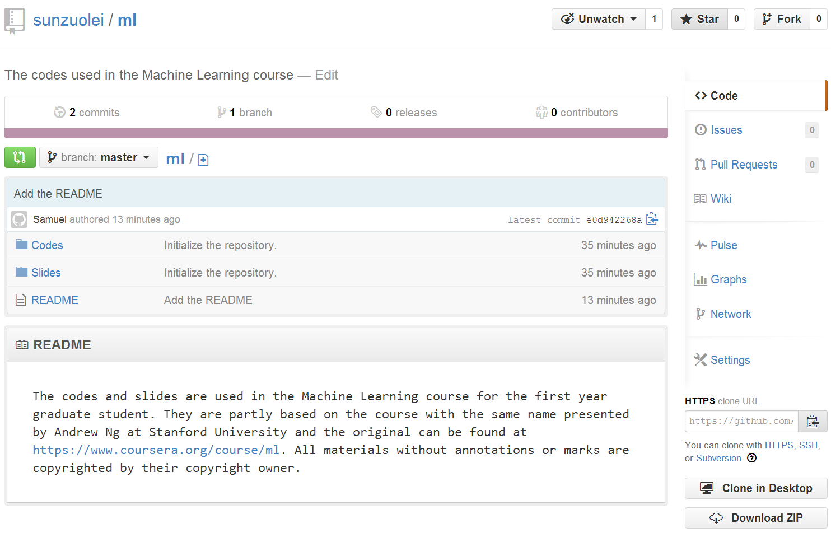

Slide 3
Supervised learning
Regression
Classification
Continuous output
Discrete output
Unsupervised learning

Slide 4
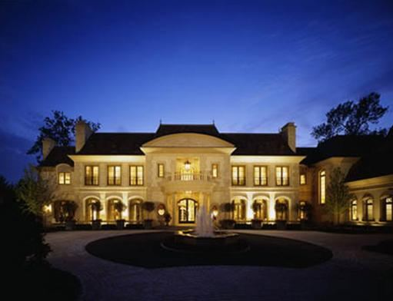

Suppose you are selling your house and you
want to know what a good market price would be.

Slide 5
Housing Prices
Price
(in 1000s of dollars)
Size (feet²)
Supervised Learning
Given the “right answer” for each example in the data.
Regression Problem
Predict real-valued output

Slide 6

Model representation
Linear regression with one variable
Machine Learning

Slide 7
Training set of
housing prices
Size in feet² (x) | Price ($) in 1000's (y)
2104 | 460
1416 | 232
1534 | 315
852 | 178
… | …
Notation:
m = Number of training examples
x’s = “input” variable / features
y’s = “output” variable / “target” variable

Slide 8
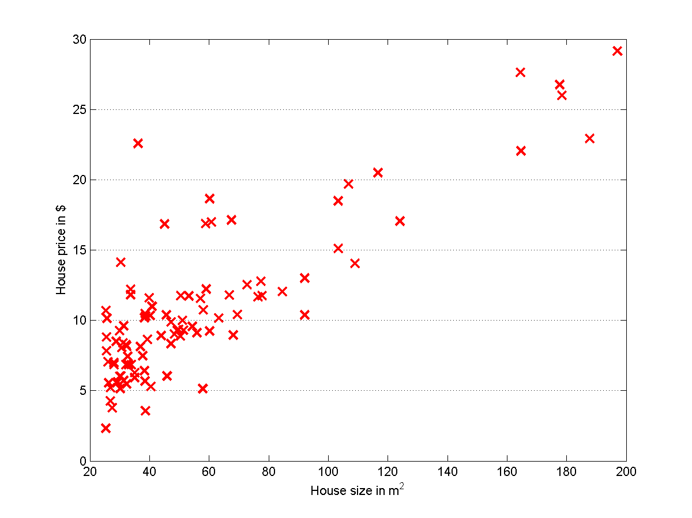
P1
Let’s implement the data visualization!

Slide 9
clear all; clc; close all;
load '../Data/dataSingleInput.mat';
figure('name', 'The data visualization')
plot(data(:, 1), data(:, 2), 'rx', 'markersize', 10, 'linewidth', 2);
grid on;
box on;
set(gca, 'xgrid', 'off');
xlabel('House size in m^2');
ylabel('House price in $');
print('data.png', '-dpng');
P1

Slide 10
Training Set
How do we represent h ?
Learning Algorithm
Hypothesis
Size of house
h
Estimated price

Slide 11
Training Set
How do we represent h ?
Learning Algorithm
Size of house
h
Estimated price
Linear regression with one variable.
Univariate linear regression.

Slide 12
Cost function
Linear regression with one variable
Machine Learning

Slide 13

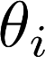
Training Set
Size in feet² (x) | Price ($) in 1000's (y)
2104 | 460
1416 | 232
1534 | 315
852 | 178
… | …
Hypothesis:
‘s: Parameters
How to choose ‘s ?

Slide 14
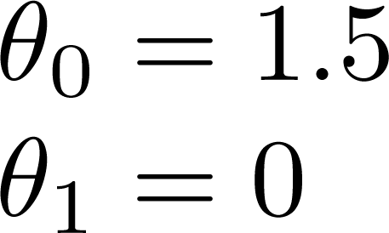
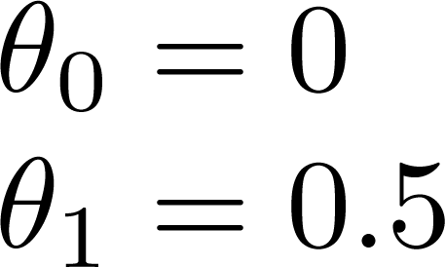
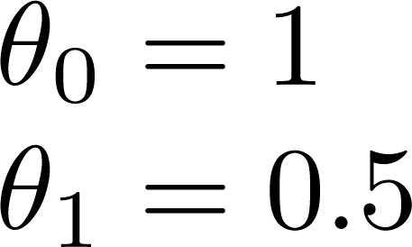

Slide 15
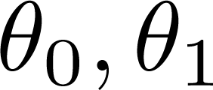
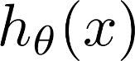

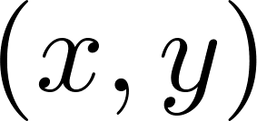
How to measure the performance of the linear fit ?
y
x
Idea: Choose so that is close to for our training examples

Slide 16
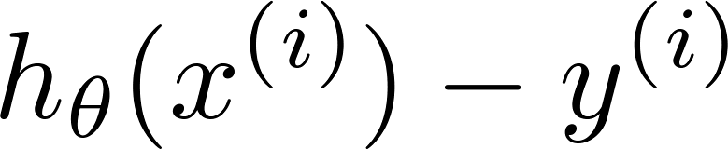

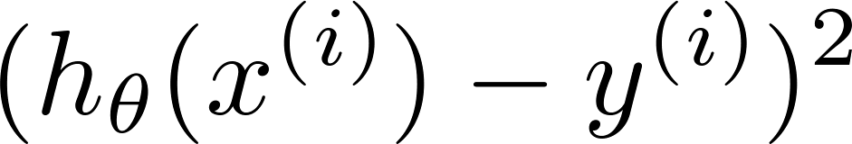
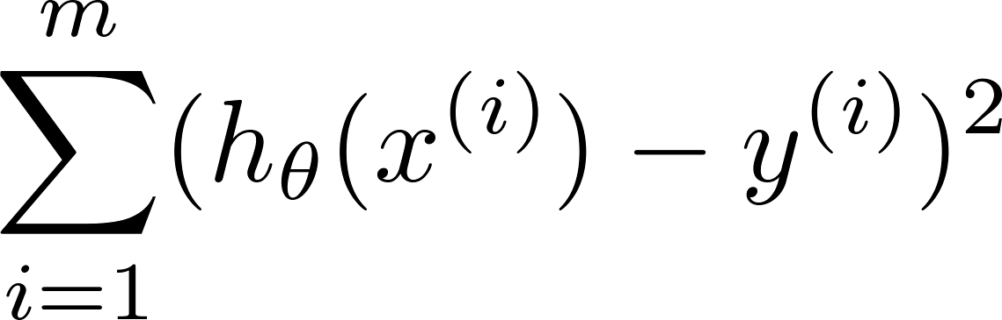
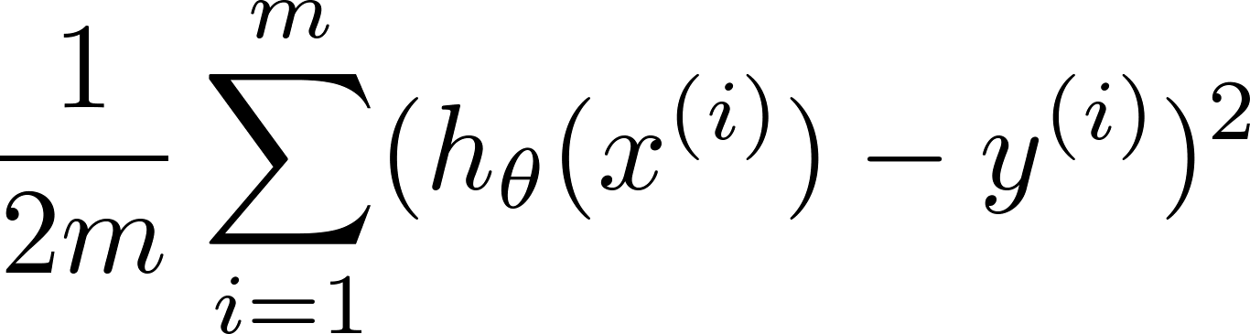
y
x
Idea: Choose so that is close to for our training examples

Slide 17
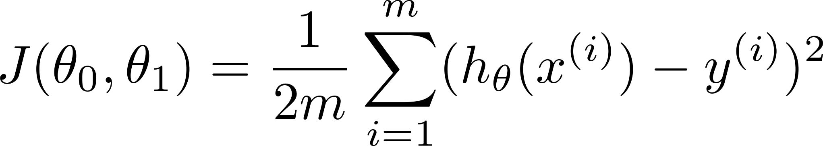
Cost function
y
x

Slide 18
Cost function intuition I
Linear regression with one variable
Machine Learning

Slide 19
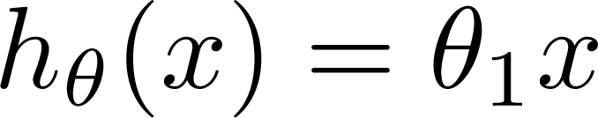
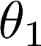
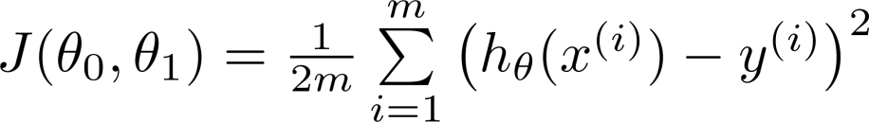
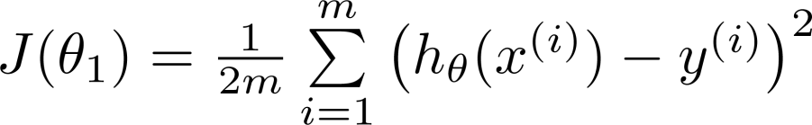
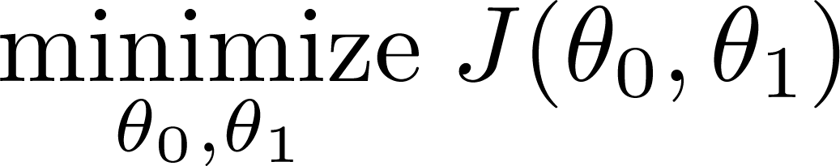
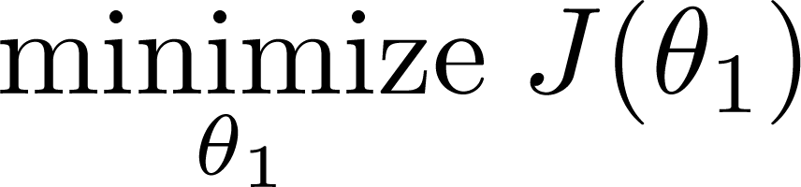
Simplified
Hypothesis:
Parameters:
Cost Function:
Goal:

Slide 20
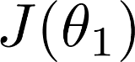
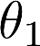
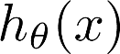
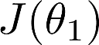
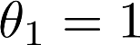
(for fixed , this is a function of x)
(function of the parameter )
y
x

Slide 21
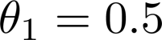
(for fixed , this is a function of x)
(function of the parameter )
y
x

Slide 22
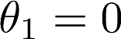
(for fixed , this is a function of x)
(function of the parameter )
y
x

Slide 23
P2
Let’s implement the cost function visualization

Slide 24
function j = computeCost(x, y, theta)
h = theta(1) + x * theta(2);
j = sum((h - y).^2 ) / (2 * length(x));
P2
theta0Seq = -35 : 0.5 : 35;
theta1Seq = -40 : 0.5 : 40;
costSeq = zeros(length(theta0Seq), length(theta1Seq));
r = 1;
for theta0 = theta0Seq
c = 1;
for theta1 = theta1Seq
costSeq(r, c) = computeCost(x, y, [theta0, theta1]);
c = c + 1;
end
r = r + 1;
end

Slide 25
Cost function intuition II
Linear regression with one variable
Machine Learning

Slide 26
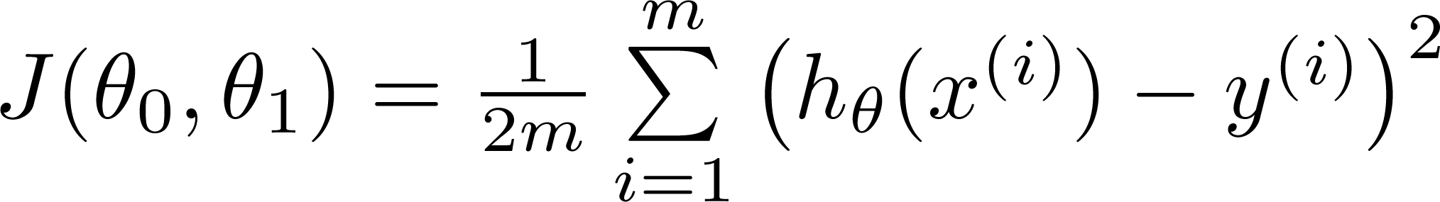
Hypothesis:
Parameters:
Cost Function:
Goal:

Slide 27
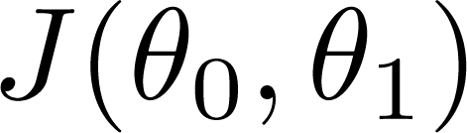
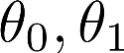
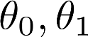
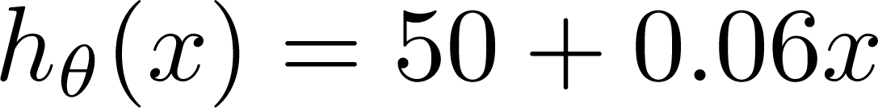
(for fixed , this is a function of x)
(function of the parameters )
Price ($)
in 1000’s
Size in feet² (x)

Slide 28
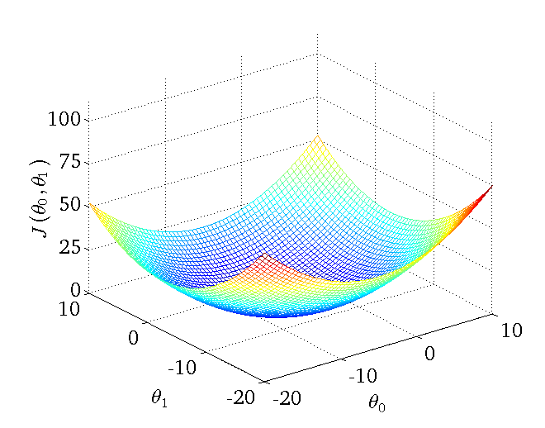

Slide 29
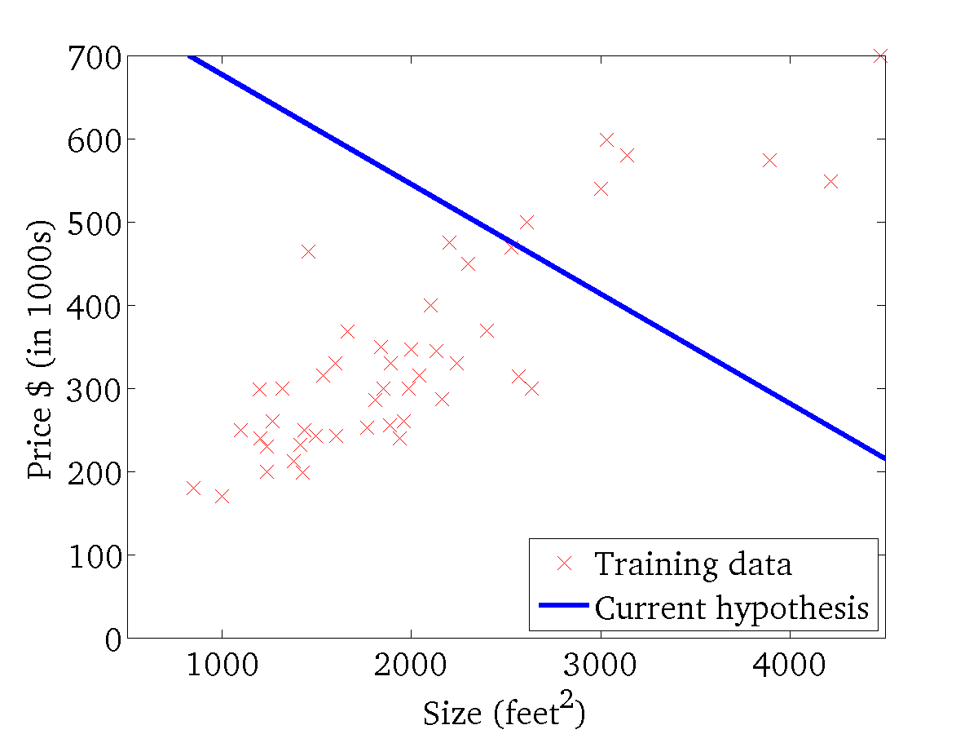
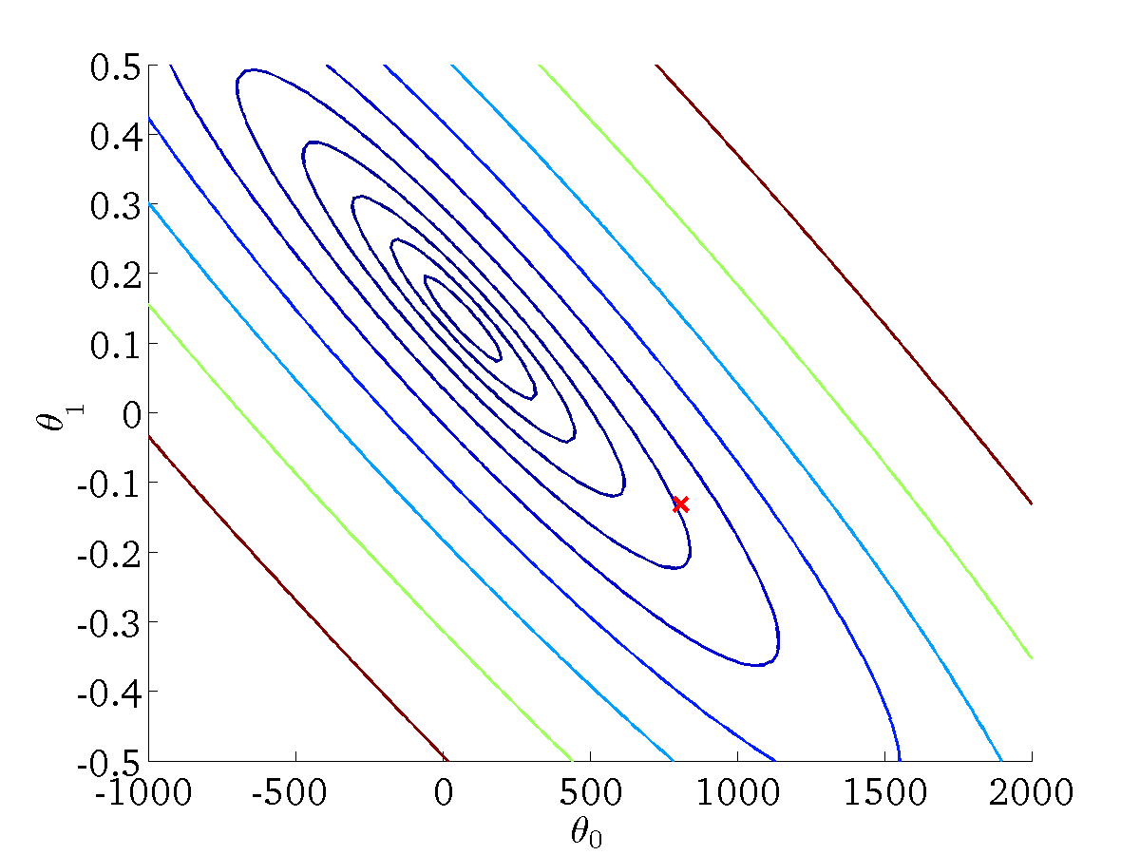
(for fixed , this is a function of x)
(function of the parameters )

Slide 30
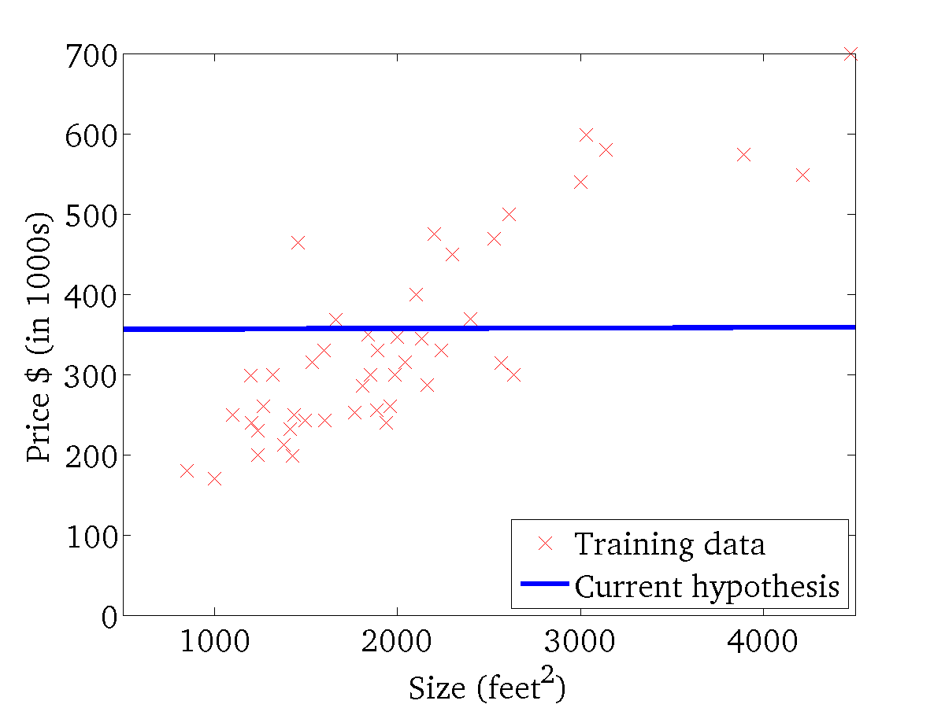
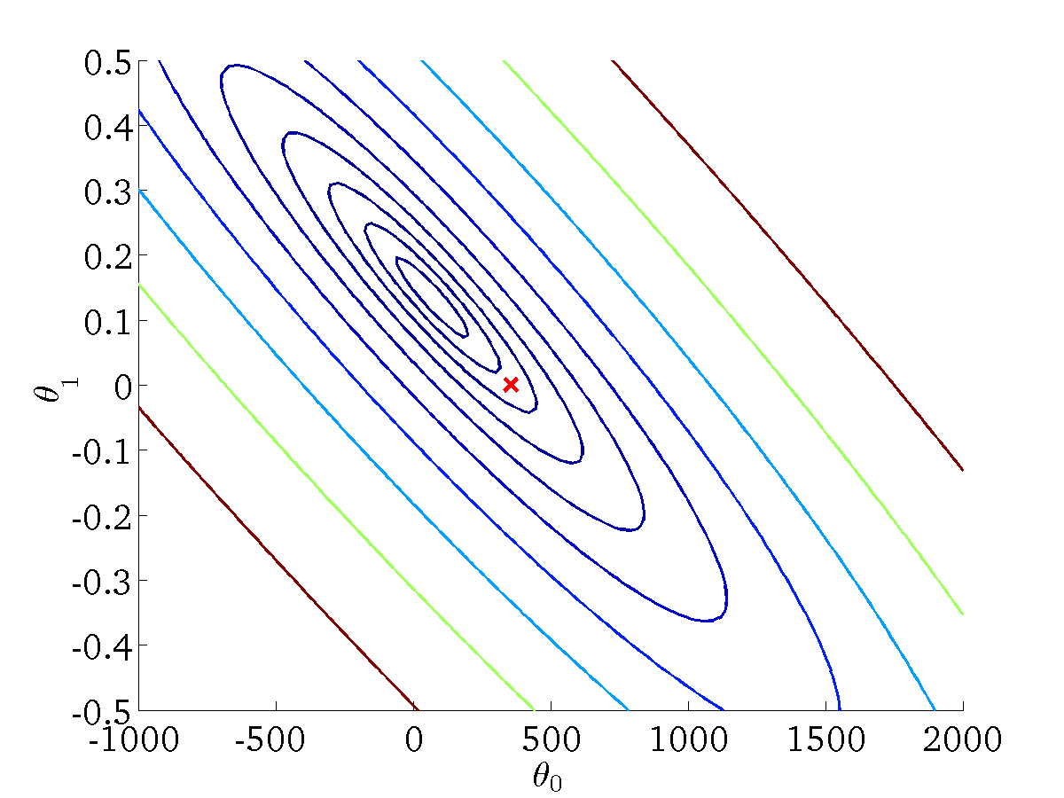
(for fixed , this is a function of x)
(function of the parameters )

Slide 31
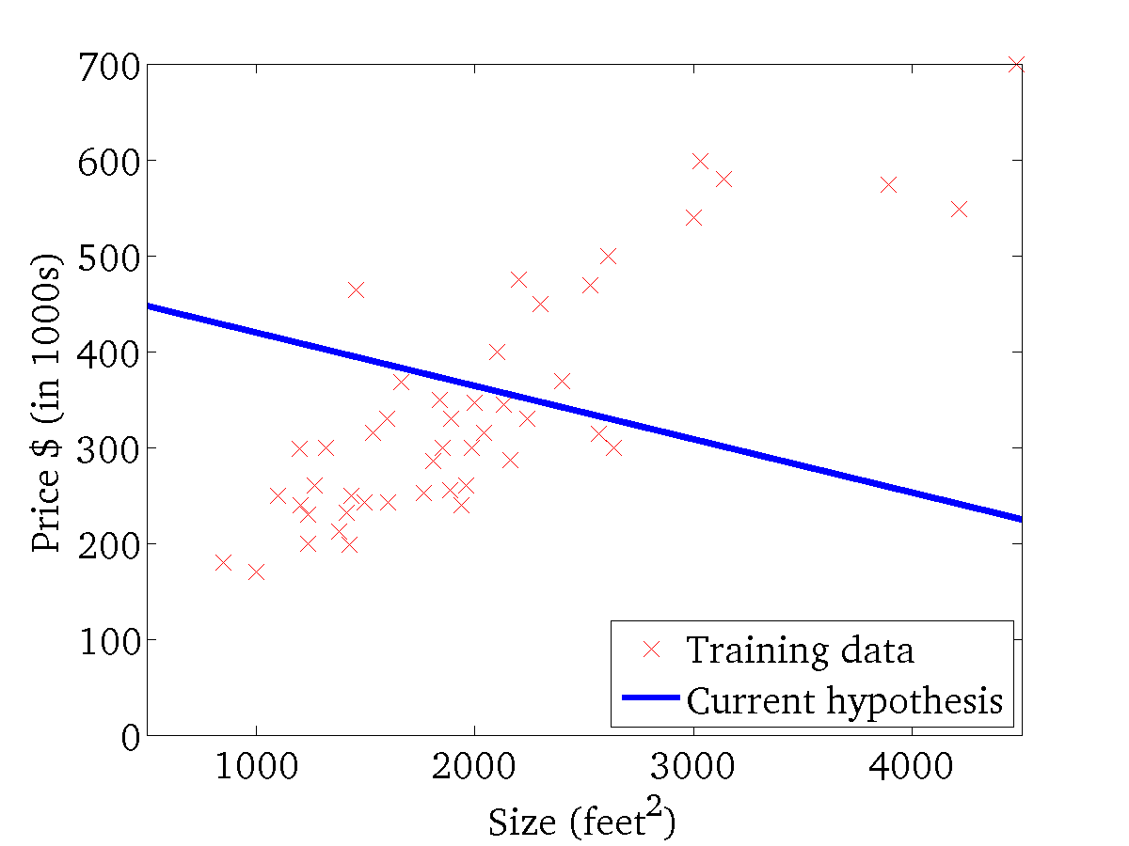

(for fixed , this is a function of x)
(function of the parameters )

Slide 32
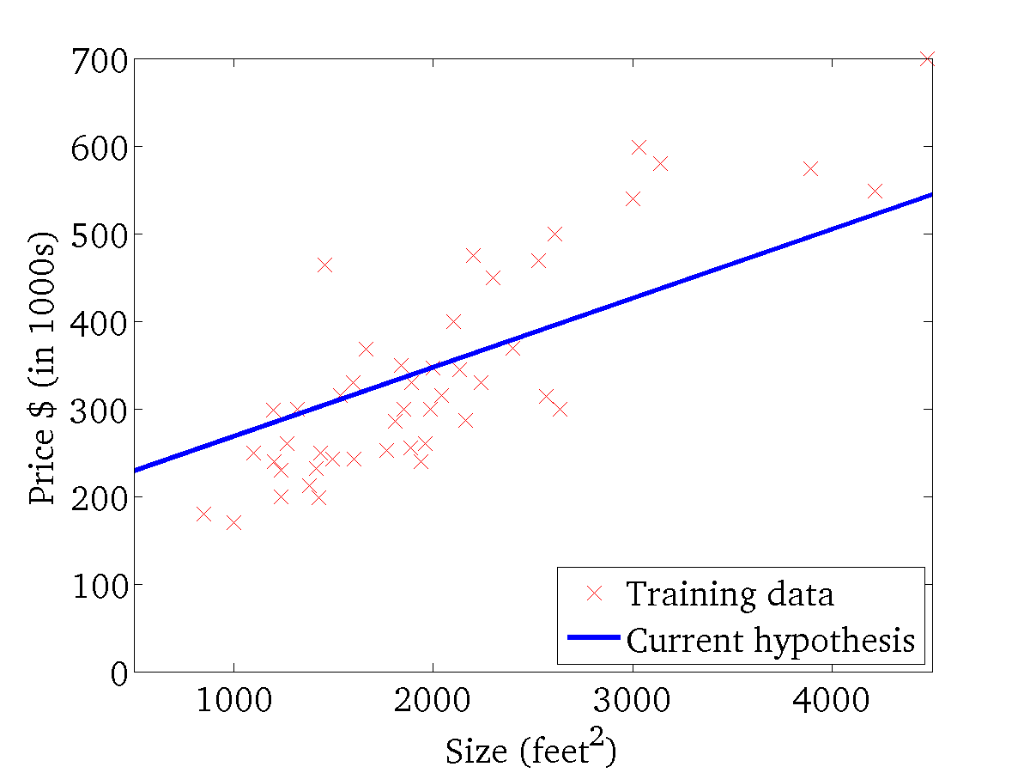
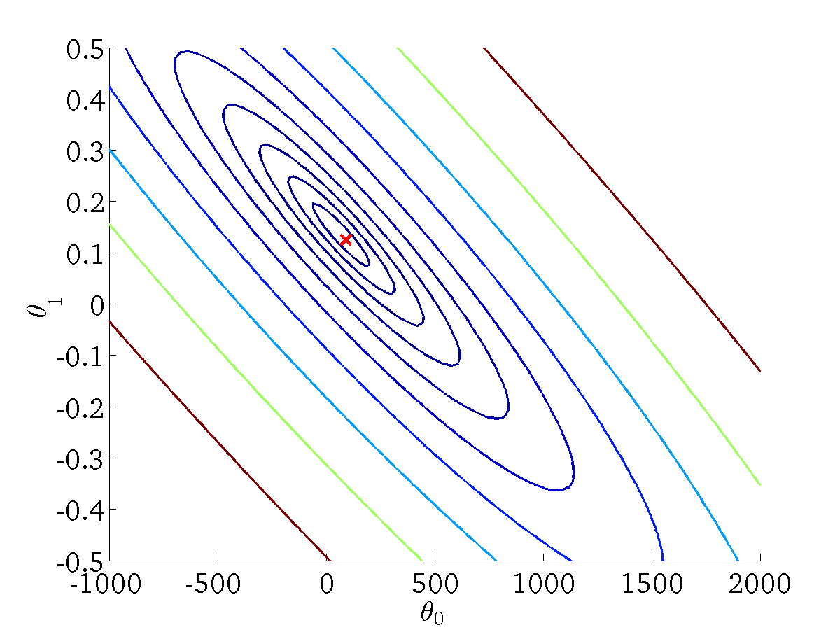
(for fixed , this is a function of x)
(function of the parameters )

Slide 33
Gradient descent
Linear regression with one variable
Machine Learning

Slide 34
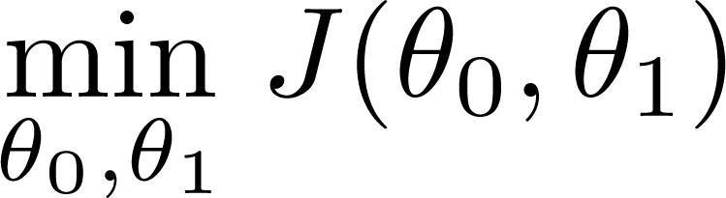
Have some function
Want
Outline:
Start with some
Keep changing to reduce until we hopefully end up at a minimum

Slide 35

J(θ₀,θ₁)
θ₁
θ₀

Slide 36
J(θ₀,θ₁)
θ₁
θ₀

Slide 37
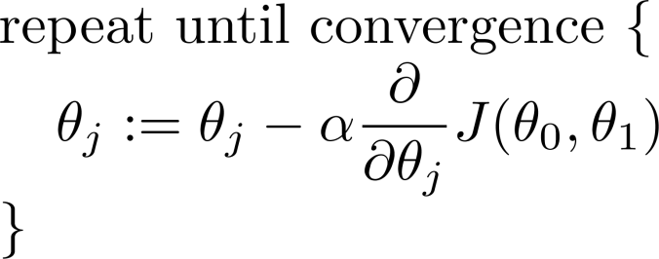
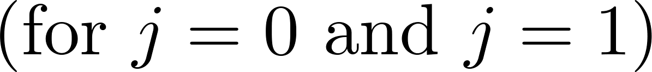
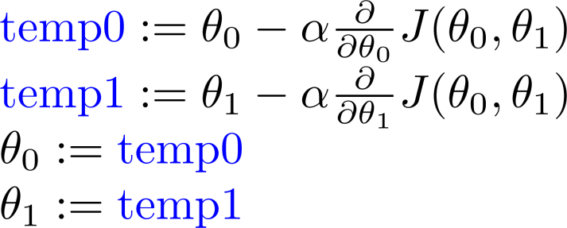
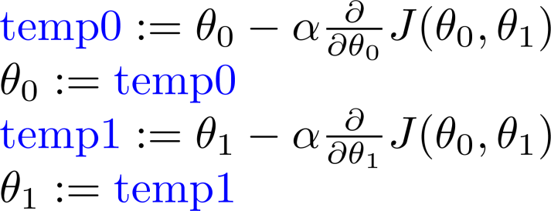
Gradient descent algorithm
Correct: Simultaneous update
Incorrect:

Slide 38
Gradient descent intuition
Linear regression with one variable
Machine Learning

Slide 39
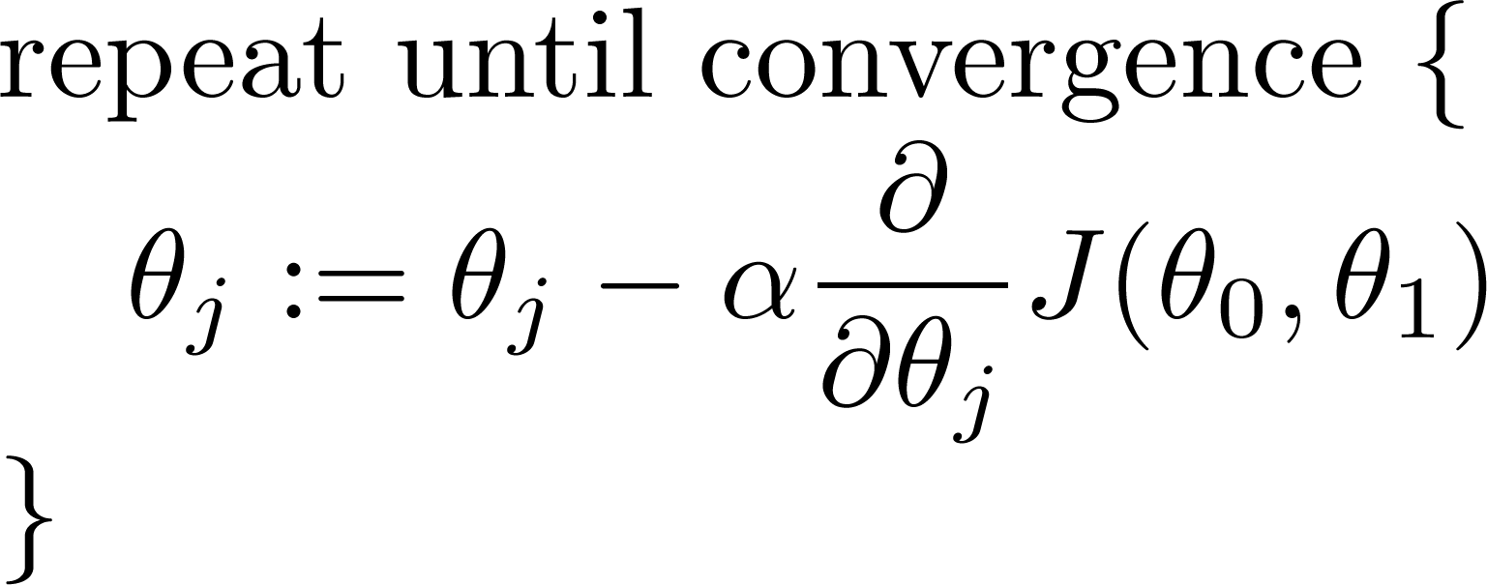
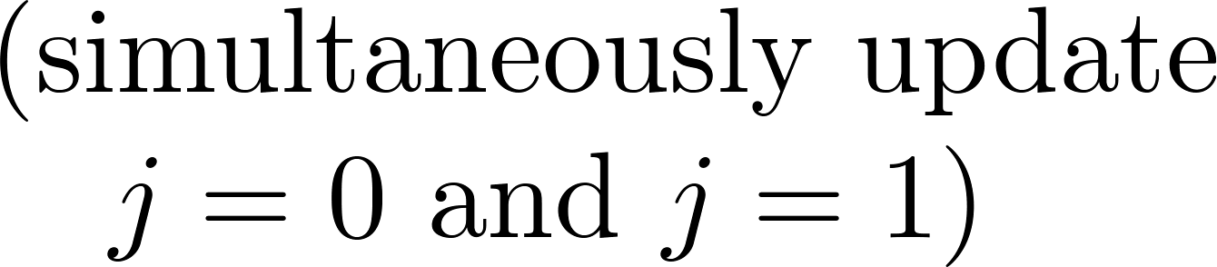
Gradient descent algorithm

Slide 41
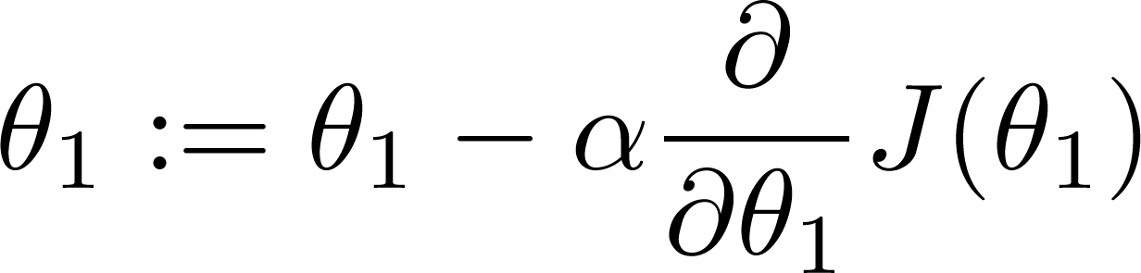
If α is too small, gradient descent can be slow.
If α is too large, gradient descent can overshoot the minimum. It may fail to converge, or even diverge.

Slide 42

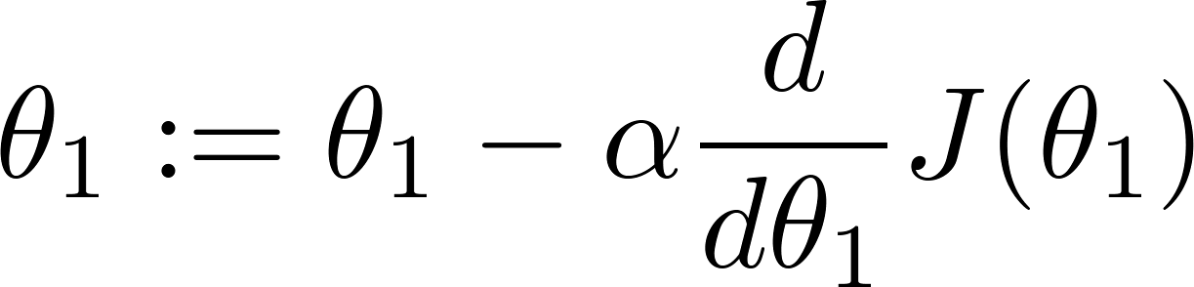
at local optima
Current value of

Slide 43
Gradient descent can converge to a local minimum, even with the learning rate α fixed.
As we approach a local minimum, gradient descent will automatically take smaller steps. So, no need to decrease α over time.

Slide 44
Gradient descent for linear regression
Linear regression with one variable
Machine Learning

Slide 45


Gradient descent algorithm
Linear Regression Model

Slide 46




Slide 47


Gradient descent algorithm
update
and
simultaneously

Slide 48
J(θ₀,θ₁)
θ₁
θ₀

Slide 49
J(θ₀,θ₁)
θ₁
θ₀

Slide 51


(for fixed , this is a function of x)
(function of the parameters )

Slide 52

(for fixed , this is a function of x)
(function of the parameters )

Slide 53


(for fixed , this is a function of x)
(function of the parameters )

Slide 54


(for fixed , this is a function of x)
(function of the parameters )

Slide 55

(for fixed , this is a function of x)
(function of the parameters )

Slide 56

(for fixed , this is a function of x)
(function of the parameters )

Slide 57


(for fixed , this is a function of x)
(function of the parameters )

Slide 58

(for fixed , this is a function of x)
(function of the parameters )

Slide 59


(for fixed , this is a function of x)
(function of the parameters )

Slide 60
“Batch” Gradient Descent
“Batch”: Each step of gradient descent uses all the training examples.

Slide 61
P3
Let’s implement the gradient descent

Slide 62
Correct: Simultaneous update
Incorrect:

